Slide 1
Modifications Made to PPT Slides

Slide 2

Modifications Made to PPT Slides
Added “Menu Import & Export” to PPT 6 Page 3 (Same for Eat In)
  理由 Changing menu contents is a time consuming job. This feature, for example enable users to export the menu contents to a CSV file, increase prices say for 10% and import again
Added Printer #2 to Department Code Entry PPT 7 Page 14 (Same for Takeaway)
  理由 This feature enables same kitchen copy output to one more printer. The #2 printer could be a sticker label printer with dish names printed separately. Users can stick the dish name label on each of the food container
接單之後不算帳, use Smartcard to beep? Sell more devices…
Add inventory status check:
  Change on User maintenance
  Added Quantity, Inventory Check on Menu Item of Takeaway and Eat In
  Added Inventory report
  If stock level fall below zero, pressing the food button would say “Out of Stock”
  BUT can Takeaway and Eat In share same inventory database?
Write & Enable Inventory
Inventory Check
Quantity
30

Slide 3
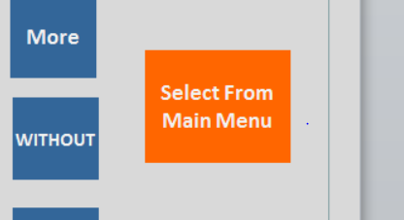
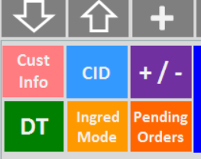
Modifications Made to PPT Slides
Hot Key function for category button
Added Caller ID port setting
No more Select from Main Menu
  Put a Ingredient Mode on the Master screen instead
  If Ingred Mode is pressed, all main dishes will be treated as if it is an ingredient
Hot Key Set Up
Hot Key
Dish Code
38
Caller ID Port Setting
Device #1
Device #2

Slide 4
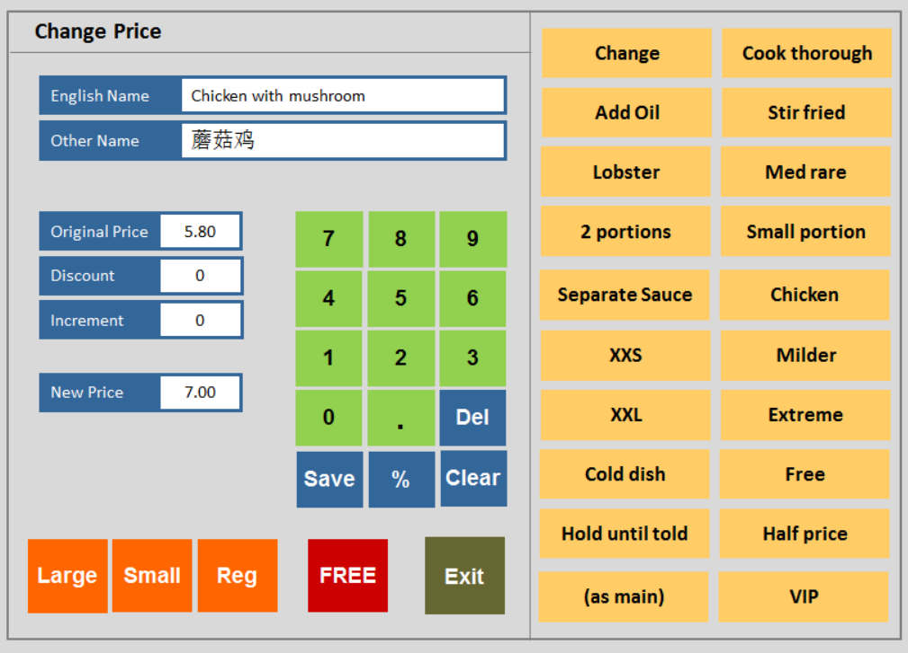
Modifications Made to PPT Slides
“Change Price” page add pre-defined wordings
  Added flexibility
  More combinations can be selected
  When the user hit the space before the Chicken and then press “half price”, the wold “half price” will be pasted before the word Chicken. On the Chinese side, the word 半价 will be inserted as well
User Maintenance now split into 4 separate pages, room for further access right additions

Slide 5
Future Plans (next phase)

Slide 6
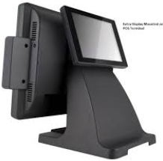
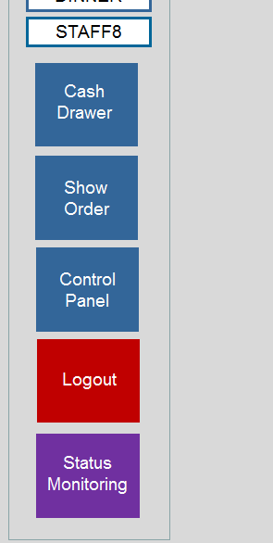
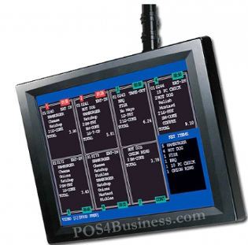
  Why? : 多賣電腦硬件，功能增值，跑贏競爭對手
Future Plans (next phase)
Second display showing item by item during the order taking process (for Takeaway only)
  Something like Customer Display pole
  Show order total at the end
  Show Change need to be made
Food preparation status monitoring touch terminal (for Takeaway only)
  Kitchen staff has a log in
  “Status Monitoring” button
  shows max 8 order on a screen
  Shows same info as kitchen print out
  “Complete” shows order finish cooking and the window will disappear
  If order on hold (cook later) will have different colour background

Slide 7
Future Plans (next phase)
Scan invoice barcode to track delivery bills, much faster than searching manually
  Barcode of the bill at the bottom of the bill
  When driver return, scan the barcode to locate the delivery bill

